Slide 1
Building Data WareHouse by Inmon
Chapter 2: The Data Warehouse Environment
Prepared by: Song Nguyen
Date: 05/09/2022

Slide 2
2. The Data Warehouse Environment
The Structure of the Data Warehouse
Subject Orientation
Day 1 to Day n Phenomenon
Granularity
Exploration and Data Mining
Living Sample Database
Partitioning as a Design Approach
Structuring Data in the Data Warehouse
Auditing and the Data Warehouse

Slide 3
2. The Data Warehouse Environment (cont.)
Data Homogeneity and Heterogeneity
Purging Warehouse Data
Reporting and the Architected Environment
The Operational Window of Opportunity
Incorrect Data in the Data Warehouse
Summary

Slide 4
2.0 Introduction – data warehouse characteristics
Subject-oriented in regards to DSS
Integrated of multiple data sources
Non-volatile data archive
Time-Variant collection of data in support of DSS report

Slide 5
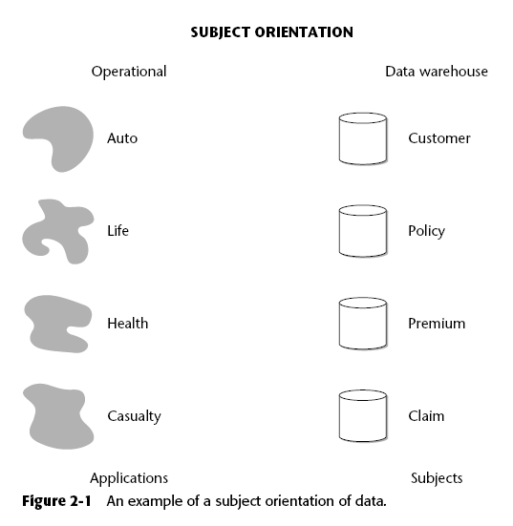
2.1. data warehouse characteristics

Slide 6
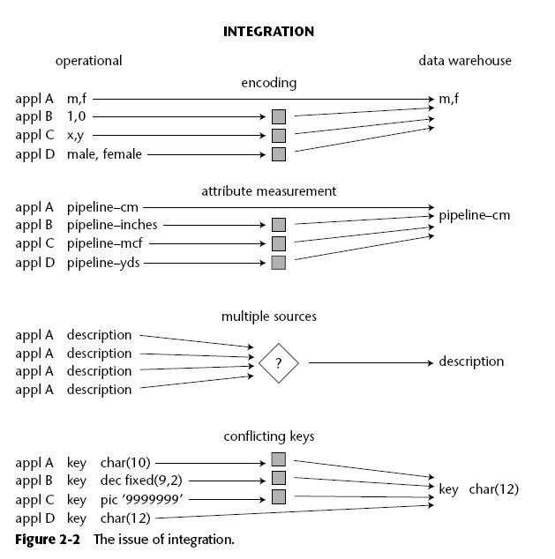
2.1. data warehouse characteristics

Slide 7
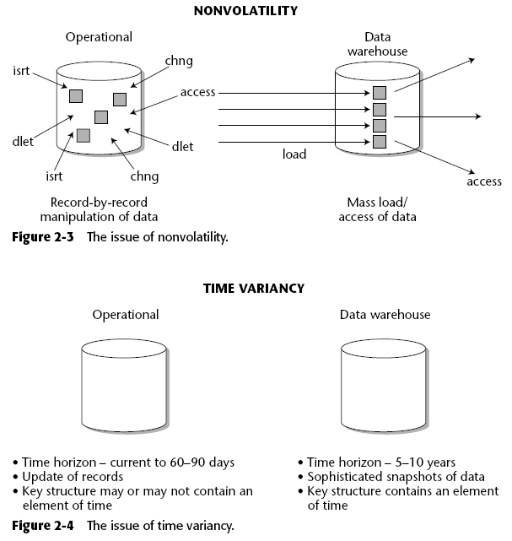
2.1. The Structure of the Data Warehouse

Slide 8
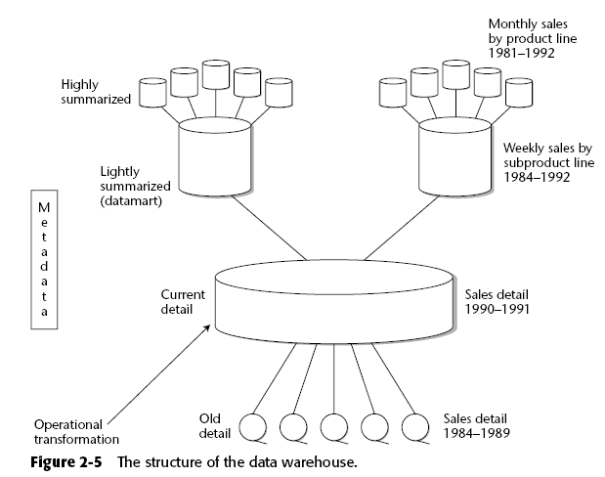
2.1 The Structure of the Data warehouse

Slide 9
2.2. Subject Orientation
The data warehouse is oriented to the major subject areas of the corporation that have been defined in the high-level corporate data model. Typical subject areas include the following:
Customer
Product
Transaction or activity
Policy
Claim
Account

Slide 10
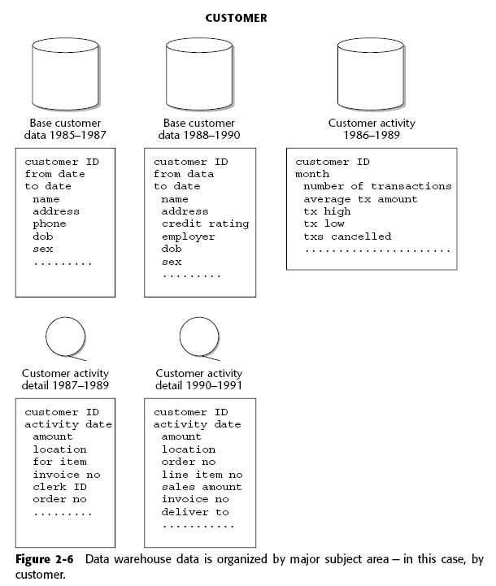
2.2.1

Slide 11
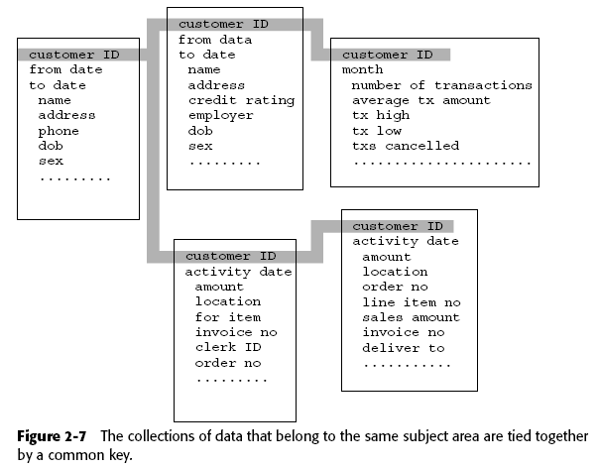
2.2.2 Subject Orientation (con’t)

Slide 12
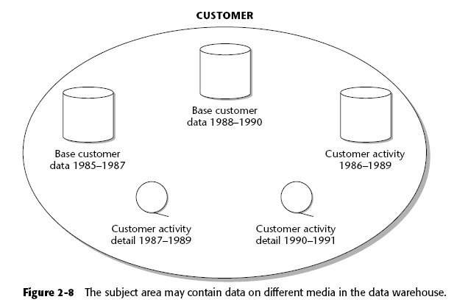
2.2.3 Subject-Orientation (con’t)

Slide 13
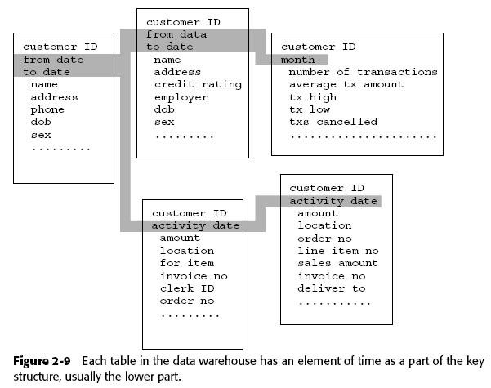
2.2.4 Subject Orientation (con’t)

Slide 14
2.3. Day 1 to Day n Phenomenon
Data warehouses are not built all at once.
data warehouse be built in an orderly, iterative, step-at-a-time fashion.
The “big bang” approach to data warehouse development is simply an invitation to disaster and is never an appropriate alternative.

Slide 15
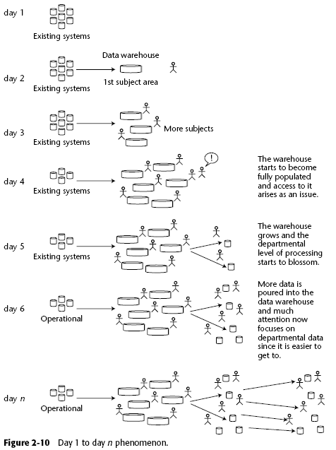

Slide 16
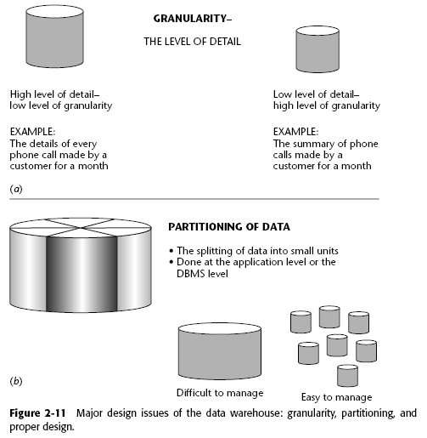
2.4. Granularity

Slide 17
2.4.1. The Benefits of Granularity
The granular data found in the data warehouse is the key to reusability.
Looking at the data in different ways is only one advantage of having a solid foundation.
Focus on specific needs of each DSS report e.g. daily, monthly, quarterly or yearly or even multiple years trending reports
Another related benefit of a low level of granularity is flexibility
Another benefit of granular data is that it contains a history of activities and events across the corporation.
largest benefit of a data warehouse foundation is that future unknown requirements can be accommodated.

Slide 18
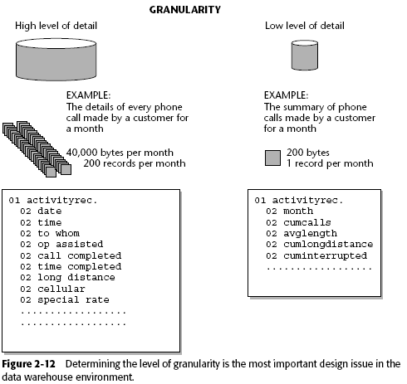
2.4.2. An Example of Granularity

Slide 19
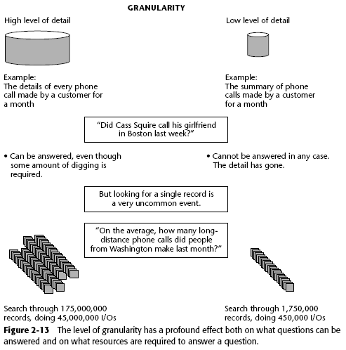
2.4.2.1

Slide 20
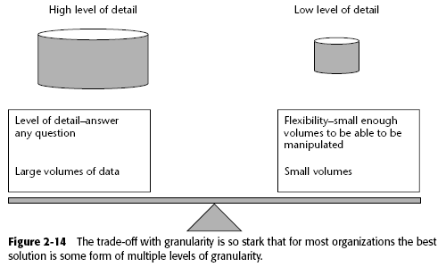
2.4.3. Dual Levels of Granularity

Slide 21
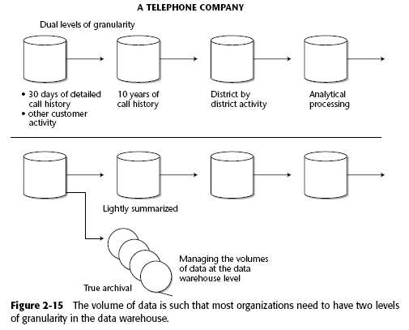
2.4.3.1 Telephone example

Slide 22
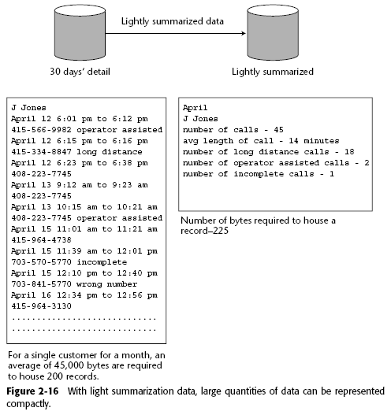
2.4.3.2 Telephone example (con’t)

Slide 23
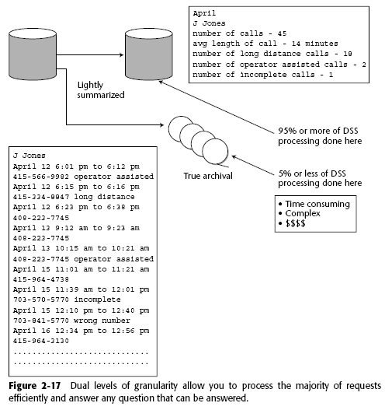
2.4.3.3 Telephone Example (cont’)

Slide 24
2.5. Exploration and Data Mining
Granular data in Data warehouse support Data marts
Support process of data mining or data exploration
References
Exploration Warehousing: Turning Business Information into Business Opportunity(Hoboken, N.J.: Wiley, 2000)

Slide 25
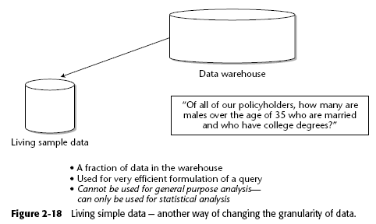
2.6. Living Sample Database

Slide 26
2.7. Partitioning as a Design Approach
Proper partitioning can benefit the data warehouse in several ways:
Loading data
Accessing data
Archiving data
Deleting data
Monitoring data
Storing data

Slide 27
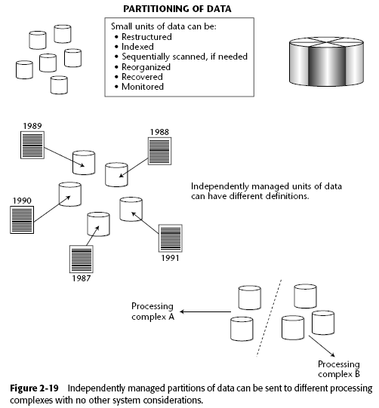
2.7.1. Partitioning of Data

Slide 28
2.7.1. Partitioning of Data (cont.)
Following are some of the tasks that cannot easily be performed when data resides in large physical units:
Restructuring
Indexing
Sequential scanning, if needed
Reorganization
Recovery
Monitoring

Slide 29
2.7.1. Partitioning of Data (cont.)
Data can be divided by many criteria, such as:
By date
By line of business
By geography
By organizational unit
By all of the above

Slide 30
2.7.1. Partitioning of Data (cont.)
As an example of how a life insurance company may choose to partition by physical units of data.
data, consider the following physical units of data:
2000 health claims
2001 health claims
2002 health claims
1999 life claims
2000 life claims
2001 life claims
2002 life claims
2000 casualty claims
2001 casualty claims
2002 casualty claims

Slide 31
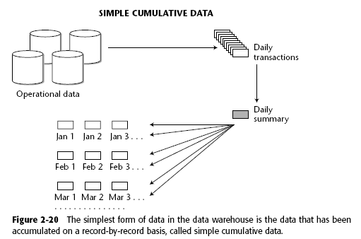
2.8 Structuring Data in the Data Warehouse

Slide 32
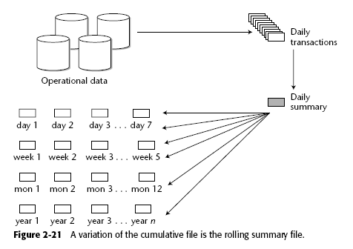
2.8 Structuring Data in the Data Warehouse (cont.)

Slide 33
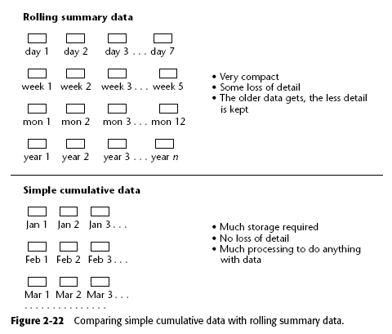
2.8 Structuring Data in the Data Warehouse (cont.)

Slide 34
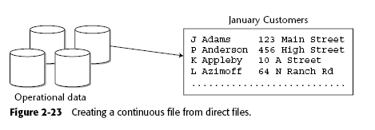
2.8 Structuring Data in the Data Warehouse (cont.)

Slide 35
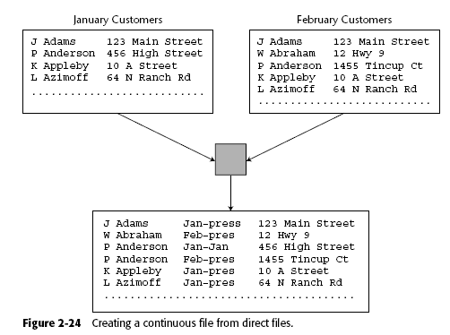
2.8 Structuring Data in the Data Warehouse (cont.)

Slide 36
2.8. Structuring Data in the Data Warehouse (cont.)
There are many more ways to structure data within the data warehouse. The most common are these:
Simple cumulative
Rolling summary
Simple direct
Continuous

Slide 37
2.8. Structuring Data in the Data Warehouse (cont.)
At the key level, data warehouse keys are inevitably compounded keys.There are two compelling reasons for this:
Date—year, year/month, year/month/day, and so on—is almost always a part of the key.
Because data warehouse data is partitioned, the different components of the partitioning show up as part of the key.

Slide 38
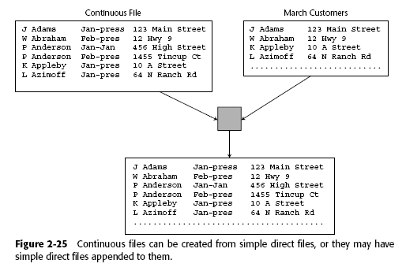
2.8. Structuring Data in the Data Warehouse (cont.)

Slide 39
2.9 Auditing and the Data Warehouse
Data that otherwise would not find its way into the warehouse suddenly has to be there.
The timing of data entry into the warehouse changes dramatically when an auditing capability is required.
The backup and recovery restrictions for the data warehouse change drastically when an auditing capability is required.
Auditing data at the warehouse forces the granularity of data in the warehouse to be at the very lowest level.

Slide 40
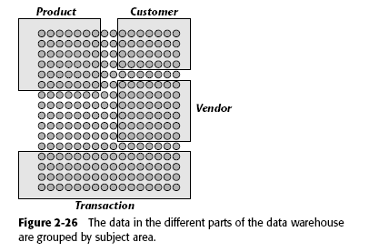
2.10 Data Homogeneity and Heterogeneity

Slide 41
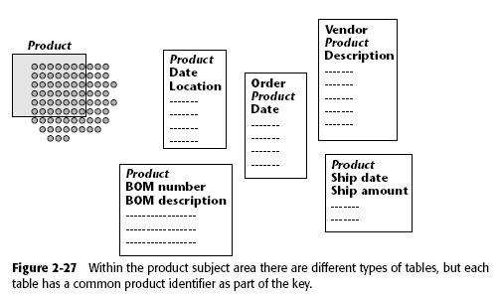
2.10 Data Homogeneity and Heterogeneity (cont.)

Slide 42
2.10 Data Homogeneity and Heterogeneity (cont.)
The data in the data warehouse then is subdivided by the following criteria:
Subject area
Table
Occurrences of data within table

Slide 43
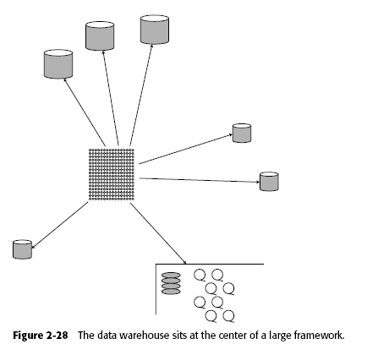
2.10. Data Homogeneity and Heterogeneity (cont.)

Slide 44
2.11 Purging Warehouse Data
There are several ways in which data is purged or the detail of data is transformed, including the following:
Data is added to a rolling summary file where detail is lost.
Data is transferred to a bulk storage medium from a high-performance medium such as DASD.
Data is actually purged from the system.
Data is transferred from one level of the architecture to another, such as from the operational level to the data warehouse level.

Slide 45
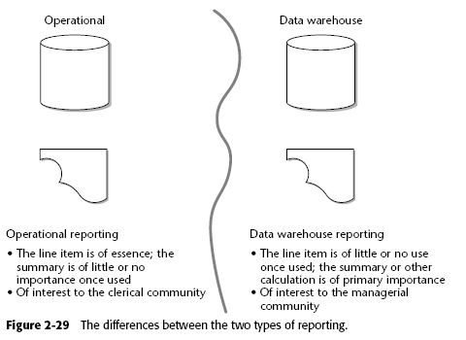
2.12 Reporting and the Architected Environment

Slide 46
2.13. The Operational Window of Opportunity
The following are some suggestions as to how the operational window of archival data may look in different industries:
Insurance—2 to 3 years
Bank trust processing—2 to 5 years
Telephone customer usage—30 to 60 days
Supplier/vendor activity—2 to 3 years
Retail banking customer account activity—30 days
Vendor activity—1 year
Loans—2 to 5 years
Retailing SKU activity—1 to 14 days
Vendor activity—1 week to 1 month
Airlines flight seat activity—30 to 90 days
Vendor/supplier activity—1 to 2 years
Public utility customer utilization—60 to 90 days
Supplier activity—1 to 5 years

Slide 47
2.14. Incorrect Data in the Data Warehouse
Choice 1: Go back into the data warehouse for July 2 and find the offending entry. Then, using update capabilities, replace the value $5,000 with the value $750.
Choice 2: Enter offsetting entries.
Choice 3: Reset the account to the proper value on August 16.

Slide 48
2.14. Incorrect Data in the Data Warehouse (cont.)
Choice 1
The integrity of the data has been destroyed. Any report running between July 2 and Aug 16 will not be able to be reconciled.
The update must be done in the data warehouse environment.
In many cases, there is not a single entry that must be corrected, but many, many entries that must be corrected.

Slide 49
2.14. Incorrect Data in the Data Warehouse (cont.)
Choice 2
Many entries may have to be corrected, not just one. Making a simple adjustment may not be an easy thing to do at all.
Sometimes the formula for correction is so complex that making an adjustment cannot be done.

Slide 50
2.14. Incorrect Data in the Data Warehouse (cont.)
Choice 2 (con’t)
The ability to simply reset an account as of one moment in time requires application and procedural conventions.
Such a resetting of values does not accurately account for the error that has been made.

Slide 51
2.15. Summary
The Structure of the Data Warehouse
Subject Orientation
Granularity
Exploration and Data Mining
Living Sample Database
Structuring Data in the Data Warehouse
Auditing and the Data Warehouse
Data Homogeneity and Heterogeneity
Purging Warehouse Data

Slide 52
2.15. Summary
Reporting and the Architected Environment
The Operational Window of Opportunity
Incorrect Data in the Data Warehouse

